Slide 1
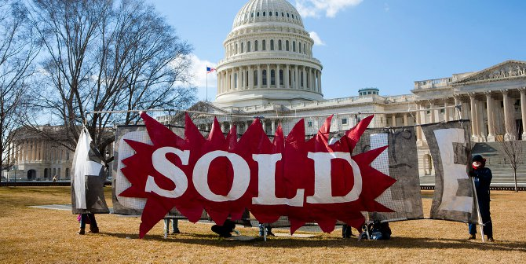

Follow the Money
Kate Field, J.A. Gorman, Angelique Tucker and Lauren Van Wagoner

Slide 2
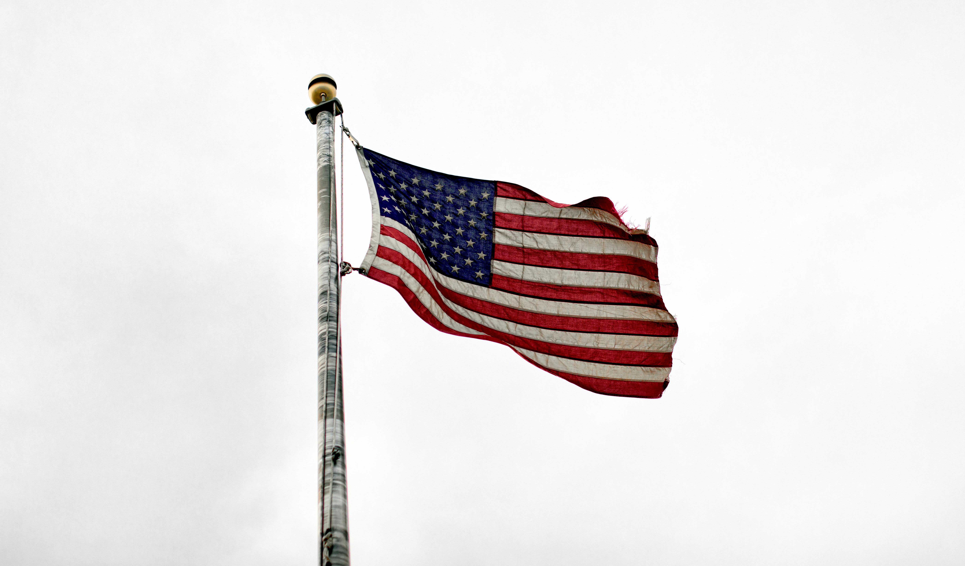
Overview
Kansas
Senate:
Jerry Moran
Roger Marshall
House Representatives:
Tracey Mann
Jake LaTurner
Sharice Davids
Ron Estes
We will be breaking down congressional districts in Kansas and Missouri to see whether or not the top donors correlate with the candidate platform for Senate and House Representatives for the states of Missouri - Senate: 2 House: 8 and Kansas- Senate: 2 House: 4.
Missouri
Senate:
Josh Hawley
Roy Blunt
House Representatives:
Cori Bush
Ann Wagner
Blaine Luetkemeyer
Vicky Hartzler
Emmanuel Cleaver
Samuel Graves
William(Billy) Long
Jason Smith
Top Donors

Slide 3
Datasets
Congressional Websites Individually
PGAdmin- PostGres
Jupyter Notebook
Mongo
API Keys
https://api.open.fec.gov/developers/
Opensecrets.org

Slide 4
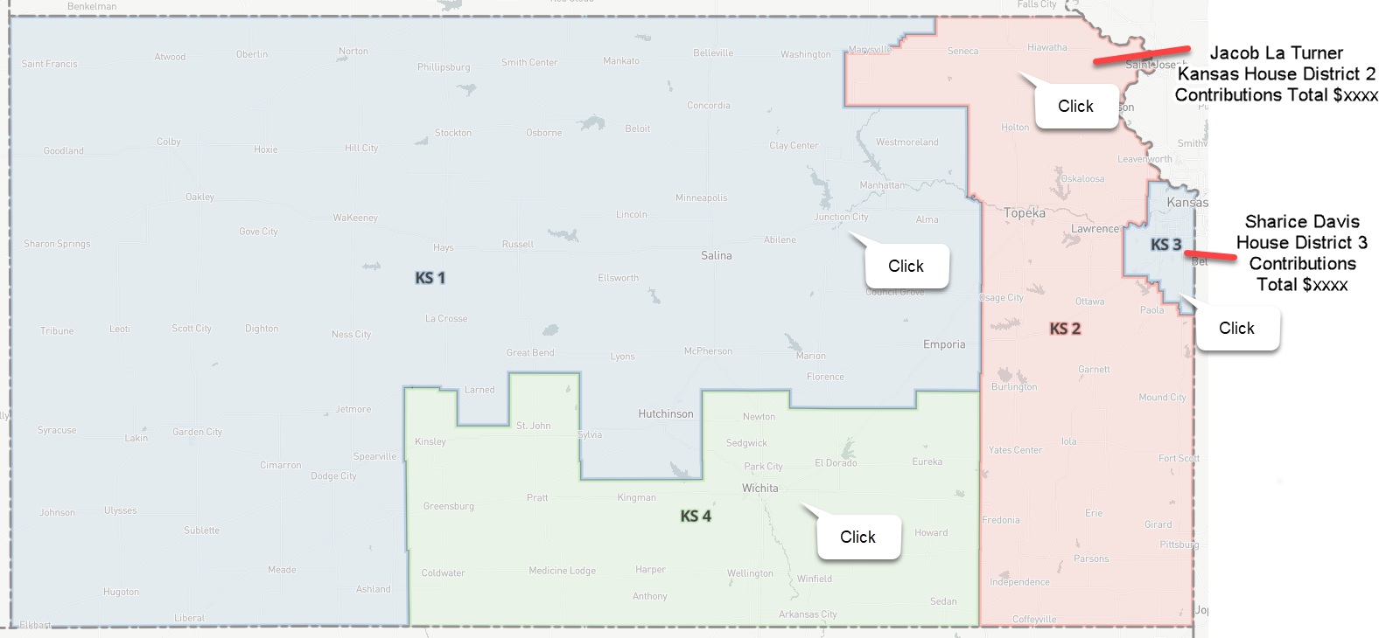
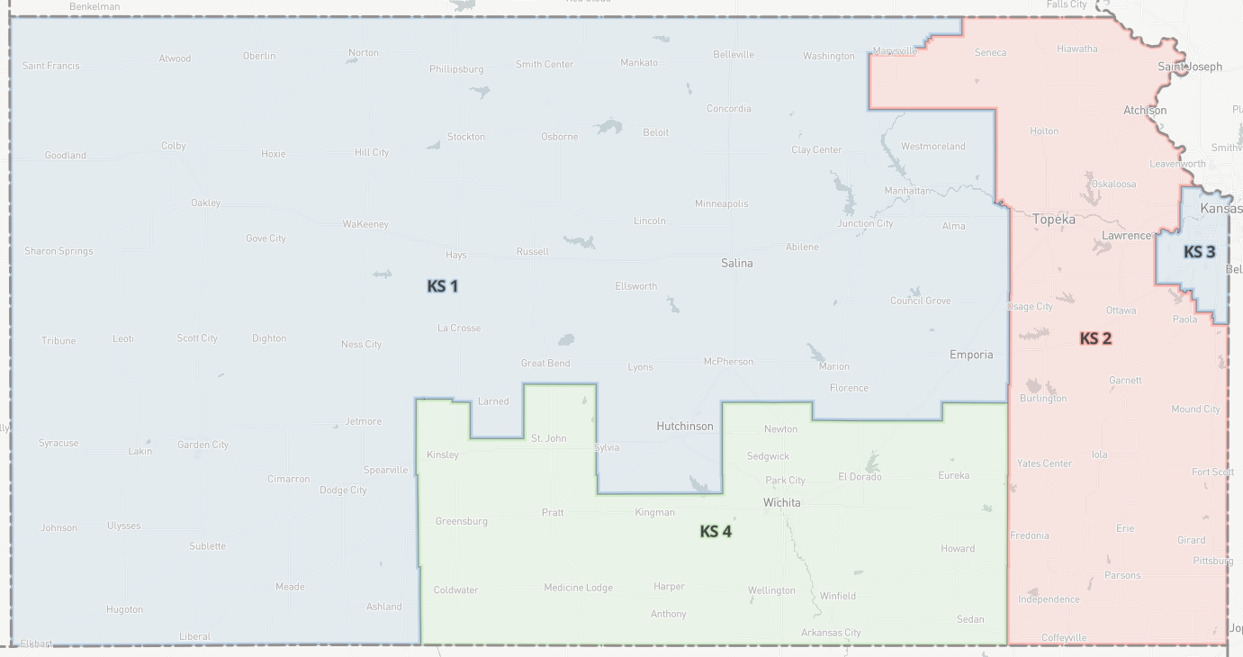
Design Sketch for Kansas

Slide 5
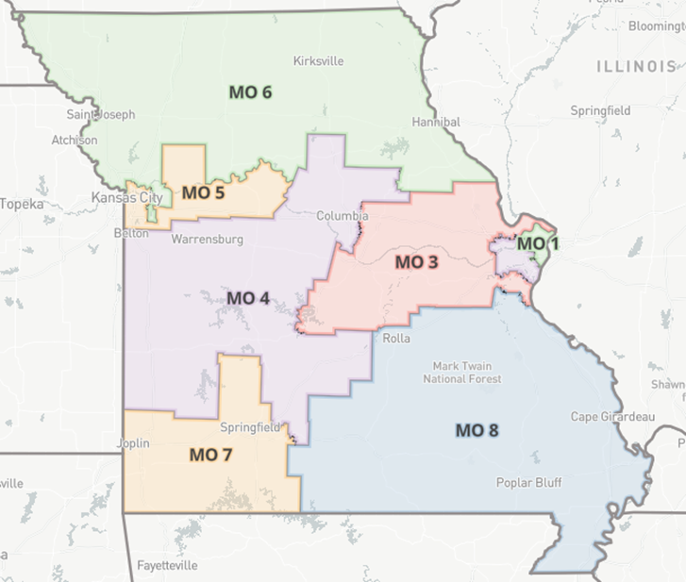
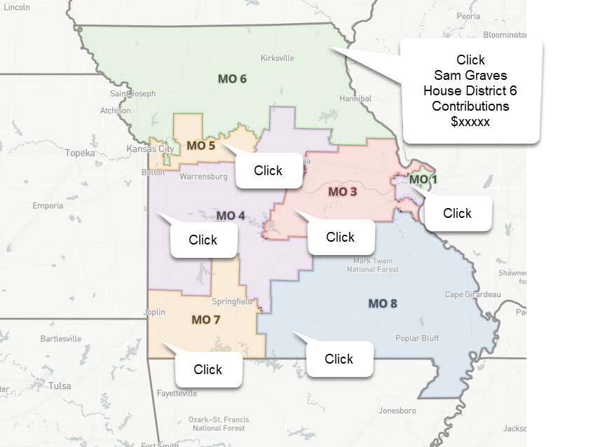
Design Sketch for Missouri

Slide 6
Difficulties
Opensource was too big for what we needed and we had to get help to narrow down the data that we needed.
The FEC website was a huge struggle to create the API Key that we needed.
Bootstrap didn’t want to work

Slide 7
Git Hub Repository
https://github.com/jagorman/Follow-the-Money

